Slide 1
Normalization of the Data Model
Fundamentals of Database Systems

Slide 2
Design Goals
Have the capability of storing all persistent data
Eliminate the redundancy
Minimize the number of relations in the Database
Normalize relations so as minimize the operation anomalies
Page <number>

Slide 3
Normalization of the Data Model
Normalization of the Data Model is the set of rules and techniques for:
  Identification relationships among attributes
  Combines attributes into relations
  Combines relations into the Database

Slide 4
Quality of the Relation Schema
Depends on:
        Semantics of attribute
        Reduction multivalued attributes
        Reduction undefined values in relations
        Avoid generating false rows into the derived relation

Slide 5
Normalization
Anomalies:
        Redundancy
        Update anomaly
        Delete anomaly
        Insert anomaly

Slide 6
#Rod_cislo | Meno | Priezvisko | Ulica | Obec | PSC | Okres | St_prisl
801106/3456 | Peter | Novák | Kamenná 27 | Banská Bystrica | 97401 | Banská Bystrica | SR
800312/7845 | Stanislav | Steinmüller | Zelená 9 | Nové Mesto nad Váhom | 91501 | Trenčín | SR
790310/2145 | Juraj | Papún | Košická cesta | Michalovce | 07101 | Michalovce | SR
781001/3623 | Andrej | Janči | Tatranská 22 | Poprad | 05801 | Poprad | SR
781130/4454 | Zdeno | Svetkovský | Janka Borodáča 12 | Prievidza | 97101 | Prievidza | SR
791225/7452 | Rastislav | Kontroš | Kolárovce 12 | Kolárovce | 01401 | Bytča | SR
770913/3326 | František | Murgaš | Námestie SNP 15 | Banská Bystrica | 97401 | Banská Bystrica | SR
810608/4543 | Ľuboš | Lehotský | Orlové 16 | Orlové | 01701 | Považská Bystrica | SR
760103/2238 | Rudolf | Kováč | Bratislavská cesta 2 | Žilina | 01001 | Žilina | SR
796123/5471 | Stanislava | Slámová | Pivovarská 14/536 | Plzeň | 30100 | Plzeň | ČR
755022/8569 | Erika | Lipovská | Priečna ulica 35 | Handlová | 97251 | Prievidza | SR
831215/7539 | Peter | Malík | Tulská 56 | Banská Bystrica | 97401 | Banská Bystrica | SR

Slide 7
Relation with anomalies
Teacher | Wage [thousand Sk] | Project | Budget [thousand Sk] | Function
Novák | 20 | Robot | 200 | technik
Biely | 30 | IDS | 5000 | analytik
Biely | 30 | IS | 5000 | analytik
Starý | 55 | IDS | 5000 | vedúci
Starý | 55 | IS | 5000 | konzultant
Starý | 55 | Robot | 200 | konzultant
Mladý | 45 | Robot | 200 | vedúci
Mladý | 45 | IS | 5000 | programátor
Veselý | 50 | IS | 5000 | programátor
Veselý | 50 | IDS | 5000 | vedúci

Slide 8
Redundancy
Teacher | Wage [thousand Sk] | Project | Budget [thousand Sk] | Function
Novák | 20 | Robot | 200 | technik
Biely | 30 | IDS | 5000 | analytik
Biely | 30 | IS | 5000 | analytik
Starý | 55 | IDS | 5000 | vedúci
Starý | 55 | IS | 5000 | konzultant
Starý | 55 | Robot | 200 | konzultant
Mladý | 45 | Robot | 200 | vedúci
Mladý | 45 | IS | 5000 | programátor
Veselý | 50 | IS | 5000 | programátor
Veselý | 50 | IDS | 5000 | vedúci

Slide 9
Update anomaly
Teacher | Wage [thousand Sk] | Project | Budget [thousand Sk] | Function
Novák | 20 | Robot | 200 | technik
Biely | 30 | IDS | 5000 | analytik
Biely | 30 | IS | 5000 | analytik
Starý | 55 | IDS | 5000 | vedúci
Starý | 55 | IS | 5000 | konzultant
Starý | 55 | Robot | 200 | konzultant
Mladý | 45 | Robot | 200 | vedúci
Mladý | 45 | IS | 5000 | programátor
Veselý | 50 | IS | 5000 | programátor
Veselý | 50 | IDS | 5000 | vedúci

Slide 10
Delete anomaly – canceling work on the projekt
#Teacher | Wage [thousand Sk] | #Project | Budget [thousand Sk] | Function
Novák | 20 | Robot | 200 | technik
Biely | 30 | IDS | 5000 | analytik
Biely | 30 | IS | 5000 | analytik
Starý | 55 | IDS | 5000 | vedúci
Starý | 55 | IS | 5000 | konzultant
Starý | 55 | Sofia | 1200 | konzultant
Mladý | 45 | IDS | 200 | vedúci
Mladý | 45 | IS | 5000 | programátor
Veselý | 50 | IS | 5000 | programátor
Veselý | 50 | IDS | 5000 | vedúci

Slide 11
Insert anomaly – no new teacher without project
Teacher | Wage [thousand Sk] | Project | Budget [thousand Sk] | Function
Novák | 20 | Robot | 200 | technik
Biely | 30 | IDS | 5000 | analytik
Biely | 30 | IS | 5000 | analytik
Starý | 55 | IDS | 5000 | vedúci
Starý | 55 | IS | 5000 | konzultant
Starý | 55 | Robot | 200 | konzultant
Mladý | 45 | Robot | 200 | vedúci
Mladý | 45 | IS | 5000 | programátor
Veselý | 50 | IS | 5000 | programátor
Veselý | 50 | IDS | 5000 | vedúci

Slide 12
Functional dependency

Slide 13
Functional dependency
Definition - Functional dependency (FD)
If exists relation R with relation schema R(A,B), where A and B are sets of attributes, then B is functional dependency on A, only when for each combination values A exists exactly only one combination values of B.
♦

Slide 14
Example
Student(meno, addr, predmet, ucitel, fakulta)
Function dependencies:
  meno -> addr
  meno -> fakulta
  predmet -> ucitel

Slide 15
ExAMPLE– Data
STUDENT STUDIED COURSE
meno addr Predmet Učiteľ Fakulta
Nový Žilina DBS A.B. FRI
Nový Žilina Algebra K.M. FRI
Stará Prievidza DBS A.B. EF
because meno -> addr
because meno -> FAkulta
because Predmet ->učiteľ

Slide 16
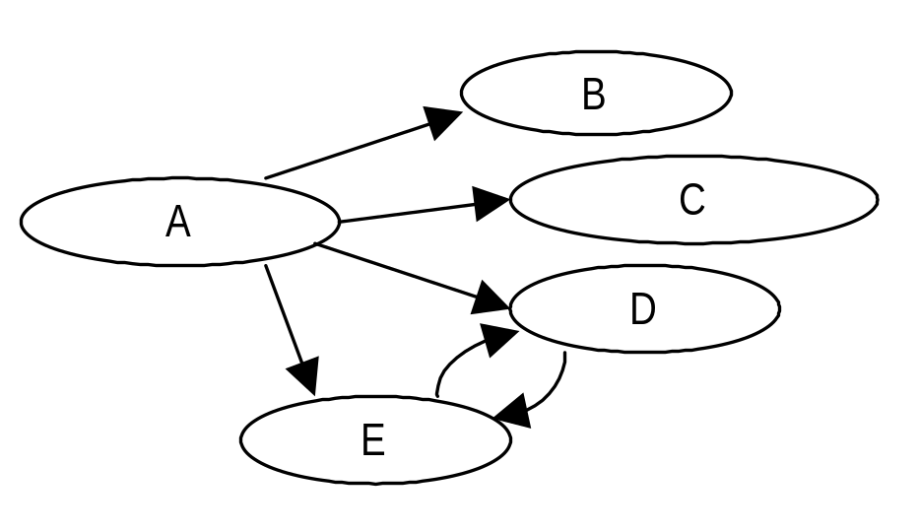
example
We have relation:
R(A, B, C, D, E), then graph of FD’s could be represented this way

Slide 17
Keys in the Relation
K is Superkey of the relation R if K functionaly derermines all attributes of R.
K is Primary key in R if K is superkey and no subset of the key K is not superkey.
Superkey of the relation is the set of attribute which contains the Primary key.

Slide 18
example
meno addr predmet učiteľ fakulta
Nový Žilina DBS A.B. FRI
Nový Žilina Algebra K.M. FRI
Starý Prievidza DBS A.B. EF
key= {meno, predmet}
But in E/R, meno is key for entity type Osoba
and predmet is key for entity type Predmety.
Notice:2 tuples for entity student Novy and
2 tuples for the entity DBS.

Slide 19
Rules
For Primary key K of the relation.
  Exists FD K -> Ai for all attributes Ai.
Derivation FD’s from the ERA model.
  From the ERA model we got Primary keys and FD’s for each entity type and for each relationship type.

Slide 20
Elementary FD
Definition – Elementary FD is functional dependency A→B, where attribut A is atomic.

Slide 21
Full FD
Definition – Fully Functional dependency (FD)
If exists relation R with relation schema R(A,B), where A and B are sets of attributes, then B is Fully Functional depends on A, only when for each attribute of B fully depends only on the whole A. (not on the part of the A)
♦

Slide 22
Mutually Functional dependency
Definition – Mutually Functional dependency
If exists relation R with relation schema R(A,B), where A and B are sets of attributes, then A and B are mutually Functionally depends, only if B functionally depends on A and at once A functionally depends on B.
♦
(A→B) and at once (B→A). ♦
Notation for Mutually Functional dependency is A↔B.

Slide 23
Transitive Functional dependency
Definition – Transitive Functional dependency
If exists relation R with relation schema R(A,B, C), where A, B and C are sets of attributes. IF A→B and B→C then C is transitive funcionally depends on A.
Transitive FD is A→C.

Slide 24
Trivial functionall dependency
Definition – Trivial Functional dependency
If exists relation R with relation schema R(A,B), where A and B are sets of attributes. Trivial functional dependency A→B when B is the subset of attributes of A.

Slide 25
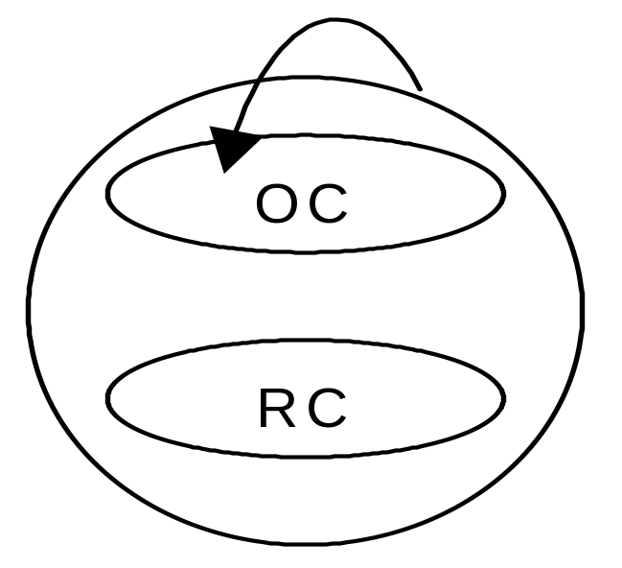
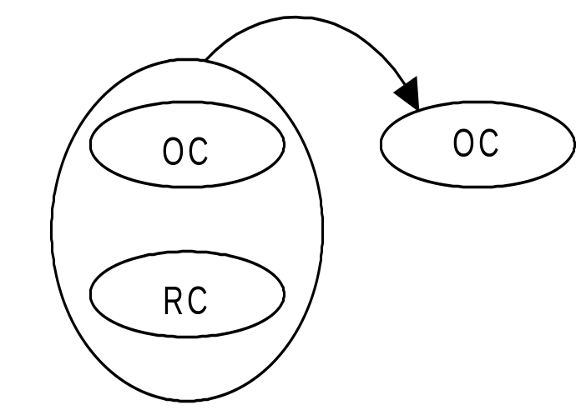
Trivial functionall dependency

Slide 26
Non-Trivial functionall dependency
Definition – Non-Trivial Functional dependency
If exists relation R with relation schema R(A,B), where A and B are sets of attributes. Non-Trivial functional dependency A→B is when at least of attributes of B not belongs into the A.

Slide 27
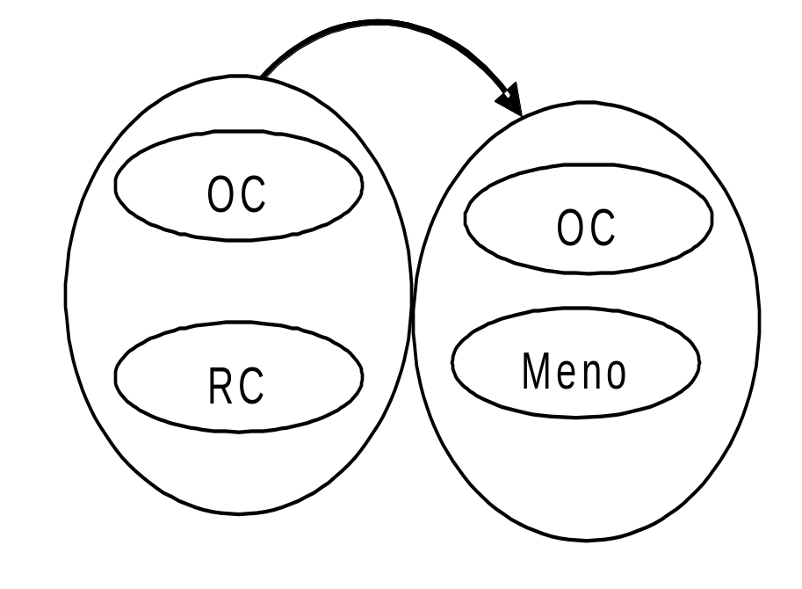
Non-Trivial Functional dependency

Slide 28
Full Non-Trivial functionall dependency
Definition – Full Non-Trivial Functional dependency
If exists relation R with relation schema R(A,B), where A and B are sets of attributes. Full Non-Trivial functional dependency A→B is when no one of attributes of B belongs into the A.

Slide 29
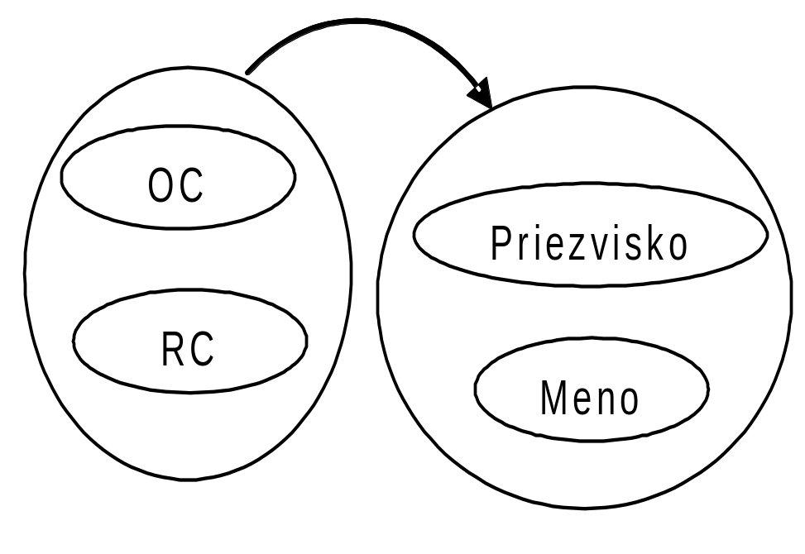
Full Non-Trivial Functional dependency

Slide 30
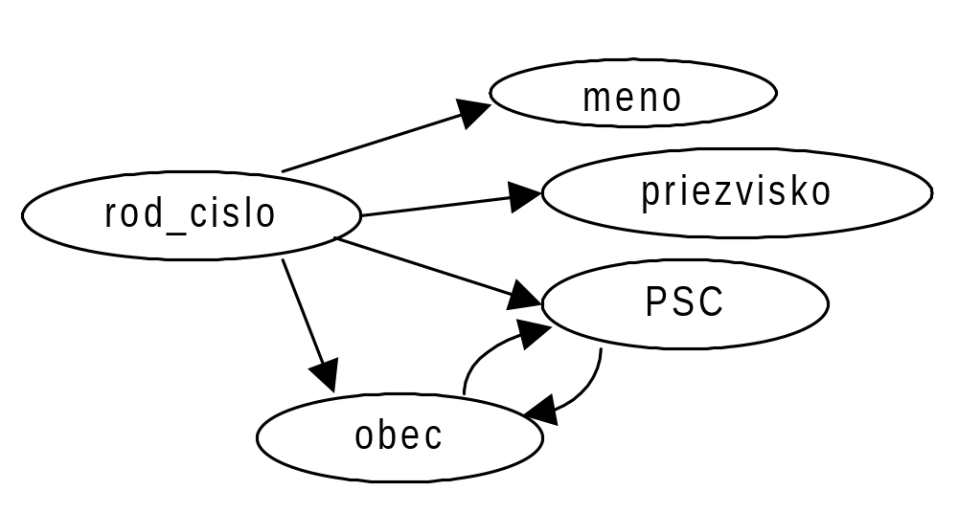
Example:
Osobne_udaje(rod_cislo, meno, priezvisko, PSC, Obec)

Slide 31
Example
FD | Elementary | Full | Mutually | Transitive
RC→meno | Y | Y | N | N
RC→priezvisko | Y | Y | N | N
RC→PSC | Y | Y | N | Y
RC→obec | Y | Y | N | Y
PSC→obec | Y | Y | Y | N

Slide 32
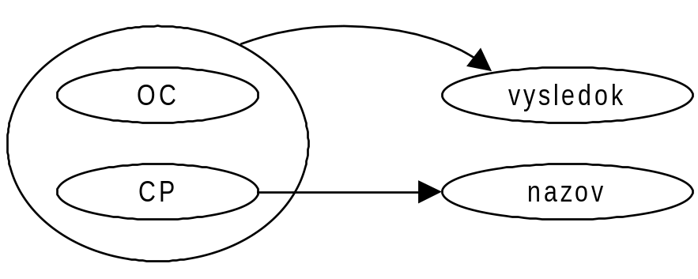
Example
Zap_predmety(OC, CP, vysledok, nazov)
FD | Elementary | Full | Mutually | Transitive
(OC, CP)→vysledok | N | Y | N | N
CP→nazov | Y | Y | N | N

Slide 33
Union
Definition - Union
Let X,Y and Z are subsets of attributes of the relation R,
if X → Y a X → Z then after Union is valid FD X → (Y,Z)
♦

Slide 34
example
Let R(Rod_číslo, Priezvisko, Meno) with follow FD’s:
Rod_číslo → Priezvisko
Rod_číslo → Meno,
After union we got FD
Rod_číslo → (Priezvisko, Meno)

Slide 35
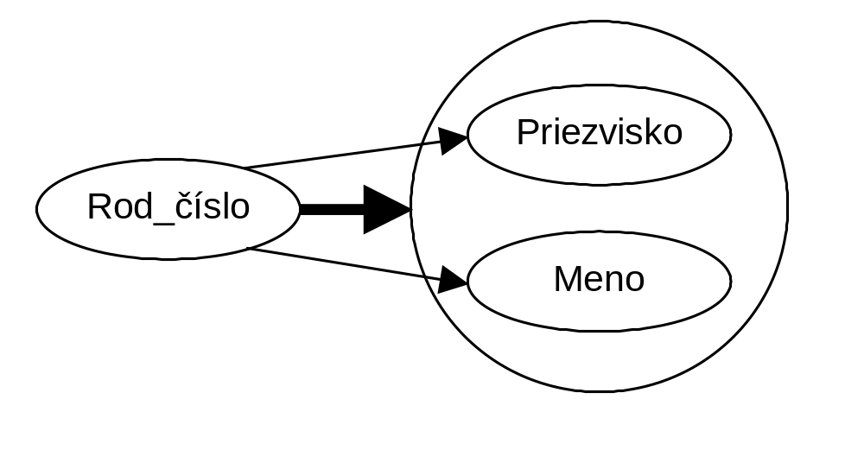
Example

Slide 36
Decomposition
Definition- Decomposition
Let X,Y a Z are subset of attributes of R, if X → Y, then exist FD X → Z, if Z is subset of Y.
♦

Slide 37
Decomposition
Let have
R(Rod_číslo, Priezvisko, Meno) with FD:
Rod_číslo → (Priezvisko, Meno)
After decomposition we got FD:
Rod_číslo → Priezvisko
Rod_číslo → Meno,

Slide 38
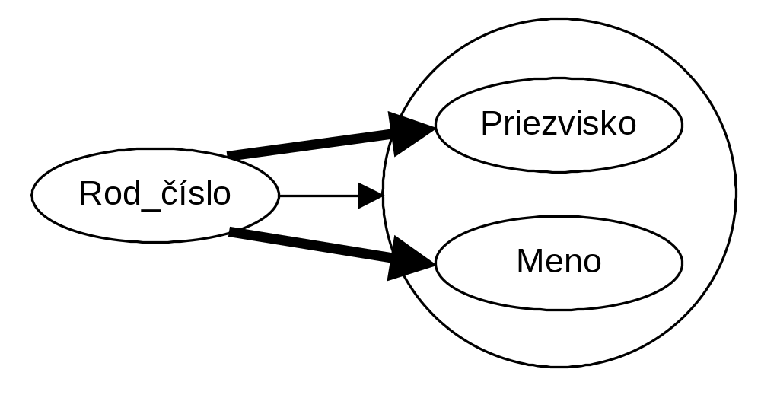
Decomposition

Slide 39
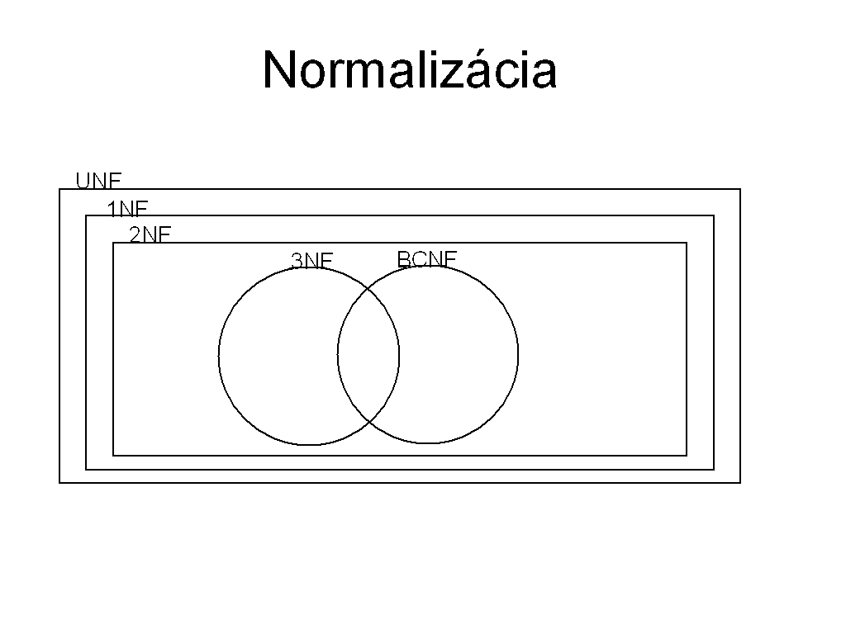
Strana <number>

Slide 40
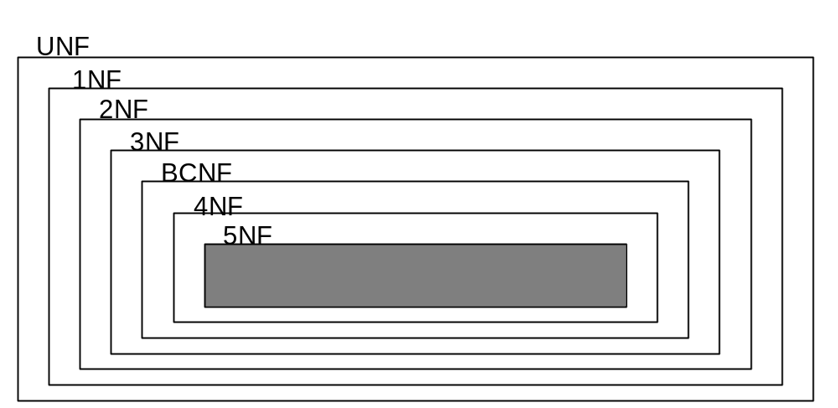
Normalization

Slide 41
Normalization
Anomalies:
        Redundancy
        Update anomaly
        Delete anomaly
        Insert anomaly

Slide 42
Normalization
Uncorect normalized relations must be transformed (decomposed), into two new relations which fulfill follow condition:
Lostless connection new relations into former one (reconstruction)
Saving all FD

Slide 43
Decomposition of the Relation
Let we have relation R(A1,A2, …, An)
Then we could decompose R into new realations S(B1,B2, …, Bm) and T(C1,C2, …, Ck) that:
{A1,…, An}= {B1,… Bm)U{C1,…,Ck}
S(B1,…Bm) is projection R(A1,…, An)
T(C1,… Ck) is projection R(A1,…, An)

Slide 44
Decomposition of the Relation
Let we have relation R(A1,A2, …, An)
Then we could decompose R into new realations S(B1,B2, …, Bm) and T(C1,C2, …, Ck) that:
{A1,…, An}= {B1,… Bm)U{C1,…,Ck}
S=π _{B1,…Bm} (R)
T=π _{C1,… Ck} (R)

Slide 45
First normal form (1NF)
Definition-
Relation is in the 1NF if and only if all underlying attributes are atomic. (the relation does not contain repeating groups of attributes).

Slide 46
decomposition –
The relation must be divided into two relation so that one of them contains repeating group of attributes and second one will contains all other attributes to ensure lostless connection for the former relation.

Slide 47
Second normal form (2NF)
Definition –
Relation R is in 2NF if only if is in 1NF and each non key attribute must be fully functionally dependent on the primary key.

Slide 48
decomposition –
The relation must be divided into two relation so that one of them contains functional dependence which violate 2NF rule and second one will contains all other attributes to ensure lostless connection for the reconstruction of the former relation.

Slide 49
Third normal form (3NF)
Definition –
Relation R is in 3NF if only if is in 2NF and each non key attribute is not functionally depends on the primary key.

Slide 50
.
decomposition –
The relation must be divided into two relation so that one of them contains transitive functional dependence and second one will contains all other attributes to ensure lostless connection for the reconstruction of the former relation.

Slide 51
The case for mutually functional dependency
If we recognize mutually functional dependency is it necessary to suggest suitable primary key because we have two candidates primary key. (Criteria: memory, application conditions, …)

Slide 52
Boyce – Codd Normal Form (BCNF)
Definition - Determinant
Determinant is the set of attributes on which some other set of attributes is functionally dependent.
♦
Notice
A→B ⇒ A je determinant

Slide 53
Boyce – Codd Normal Form (BCNF)
Definition - BCNF
A relation R is in BCNF if and only if every determinant is a Candidate Primary key.

Slide 54
Boyce – Codd Normal Form (BCNF)
BCNF normalization Algorithm :
Crete unnormalized relation (UNR)
Find all FD’s
Make the test for BCNF
– if each relation is in BCNF ⇒ END
  - if any relation is not in BCNF ⇒ make decomposition of this one
Repeat steps 2,3 for all new relations

Slide 55
Anomalies between 3NF and BCNF
Relation is in 3NF and not in BCNF or
Relation is in BCNF and not in 3NF:
More candidates PK
Candidate of PK is composite
Composite PK are overlapping

Slide 56
Relation is in 3NF and not in BCNF
Let have the relation VYUKA(#Student, #Predmet, #Ucitel)
With follow instancies:
S1 | P1 | U1
S2 | P1 | U2
S2 | P2 | U3
S2 | P3 | U4
S3 | P1 | U1
S3 | P2 | U3
S4 | P1 | U5
S5 | P1 | U2

Slide 57
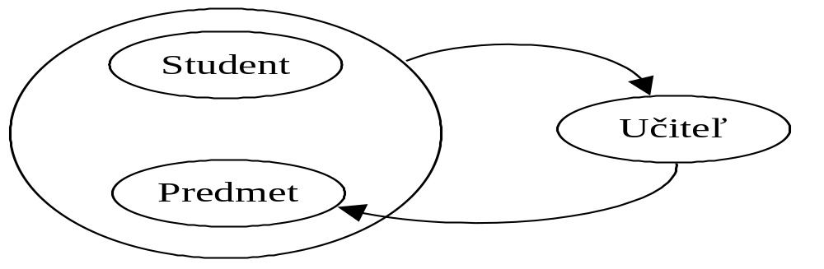
Relation is in 3NF and not in BCNF
Let have the relation VYUKA(#Student, #Predmet, #Ucitel) :
For decomposition we have 3 variants:
R1(#Student, #Ucitel), R2(#Student, #Predmet)
R1(#Ucitel, Predmet), R2(#Student, #Predmet)
R1(#Ucitel, Predmet), R2(#Student, #Ucitel)

Slide 58
S | P | U |  | S | U |  | S | P
S1 | P1 | U1 |  | S1 | U1 |  | S1 | P1
S2 | P1 | U2 |  | S2 | U2 |  | S2 | P1
S2 | P2 | U3 |  | S2 | U3 |  | S2 | P2
S2 | P3 | U4 |  | S2 | U4 |  | S2 | P3
S3 | P1 | U1 | → | S3 | U1 |  | S3 | P1
S3 | P2 | U3 |  | S3 | U3 |  | S3 | P2
S4 | P1 | U5 |  | S4 | U5 |  | S4 | P1
S5 | P1 | U2 |  | S5 | U2 |  | S5 | P1
 |  |  | After reconstruction ???

Slide 59
 | S | P | U |  | U | P |  | S | P
 | S1 | P1 | U1 |  | U1 | P1 |  | S1 | P1
 | S2 | P1 | U2 |  | U2 | P1 |  | S2 | P1
 | S2 | P2 | U3 |  | U3 | P2 |  | S2 | P2
 | S2 | P3 | U4 |  | U4 | P3 |  | S2 | P3
 | S3 | P1 | U1 | → | U1 | P1 |  | S3 | P1
 | S3 | P2 | U3 |  | U3 | P2 |  | S3 | P2
 | S4 | P1 | U5 |  | U5 | P1 |  | S4 | P1
 | S5 | P1 | U2 |  | U2 | P1 |  | S5 | P1
 |  |  |  | After reconstruction ???

Slide 60
 | S | P | U |  | U | P |  | S | U
 | S1 | P1 | U1 |  | U1 | P1 |  | S1 | U1
 | S2 | P1 | U2 |  | U2 | P1 |  | S2 | U2
 | S2 | P2 | U3 |  | U3 | P2 |  | S2 | U3
 | S2 | P3 | U4 |  | U4 | P3 |  | S2 | U4
 | S3 | P1 | U1 | → | U1 | P1 |  | S3 | U1
 | S3 | P2 | U3 |  | U3 | P2 |  | S3 | U3
 | S4 | P1 | U5 |  | U5 | P1 |  | S4 | U5
 | S5 | P1 | U2 |  | U2 | P1 |  | S5 | U2
 |  |  |  | After reconstruction ???

Slide 61
Relation is in BCNF and not in 3NF:
We have
R(os_cislo,rod_cislo,Meno,Priezvisko,PSC)
Candidates of PK are: os_cislo, alebo rod_cislo.

Slide 62
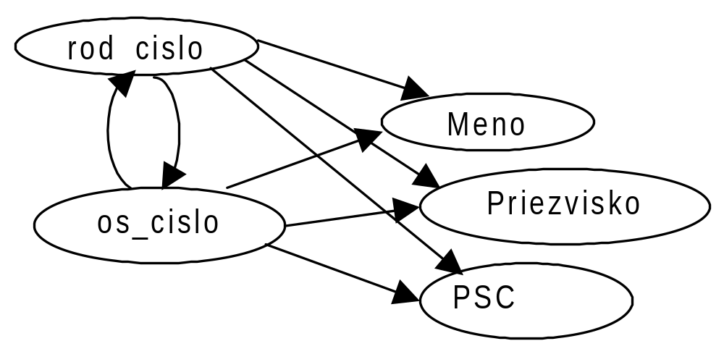
Relation is in BCNF and not in 3NF

Slide 63


UNIVERSITY OF ZILINA
FACULTY OF MANAGEMENT SCIENCE AND INFORMATICS
DEPARTMENT OF INFORMATICS
Univerzitna 8215/1SK-01026, Zilina, Slovak Republic
Phone: +421-41-513 4040
Fax: +421-41-513 4055
Homepage: http://www.fri.uniza.sk
Introduction
The Department of Informatics comprises around 20 academics and research fellows who form research community in Computer Science. Its complement of people directly involved in research is close to 50. The Department is strongly involved in many practical collaborative industry projects and research projects on national and international level.
Research
Research addresses the fundamentals of computer systems, architectures, database systems and information analysis. The key research topics cover distributed and parallel systems and advanced database systems.
prof. Ing. Karol Matiaško, PhD.
Karol.matiasko@fri.uniza.sk
Department of Informatics
Faculty of Management Science and Informatics
University of Zilina
Strana <number>

